Slide 1


WRITING UP RESEARCH
Experimental Research Report Writing for Students of English
Services Computing Research Group
School of Electrical Engineering and Informatics
Institut Teknologi Bandung
Pelatihan Publikasi Karya Tulis Ilmiah Untuk Konferensi Internasional IEEE
Padang, November, 28-29 2017

Slide 2
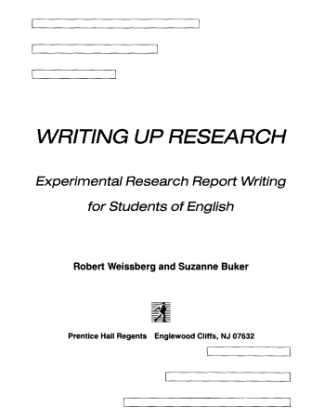
WRITING UP RESEARCH
Experimental Research Report Writing for Students of English
Robert Weisberg and Suzanne Buker
Prentice Hall Regents

Slide 3
INTRODUCTION
Abstract provides te reader with a brief preview of your study based on the information from other sections of the report.
The Introduction serves as an orientation for readers of the report, giving them perspective they need to understand the detailed information of your research.
Method describes the steps you followed in conducting your study and the materials you used at each step. The method section is useful for readers who want to know how the methodology of your study may have influenced your results, or who are interested in replicating or extending your study.
Results present the findings of your study and briefly comment on them, including only brief comments focused on the statistical analysis.
Discussion indicates more extensive comments on the findings of the study, reserving the more general comments. It allows you to take a step back and take a broad look at your findings and your study as a whole.
ABSTRACT
INTRODUCTION
METHOD
RESULTS
DISCUSSION

Slide 4
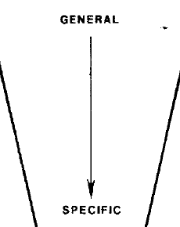
INTRODUCTION—Five Stages
First Stage: General statements about a field of research to provide the reader with a setting for the problem to be reported
Second Stage: More specific statements about the aspects of the problem already studied by other researchers
Third Stage: Statements that indicate the need for more investigation
Fourth Stage: Very specific statements giving the purpose/objectives of the writer’s study (Your thesis statement)
Fifth Stage: Optional statements that give a value or justification for carrying out the study
1st Stage
2nd Stage
3rd Stage
4th Stage
5th Stage

Slide 5
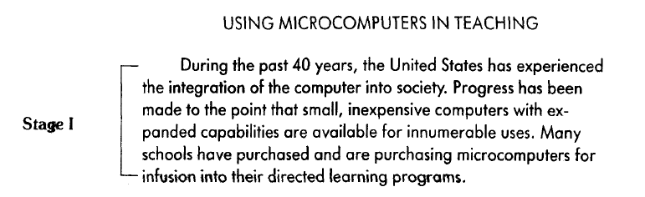
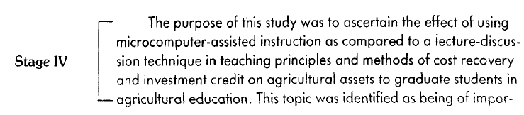

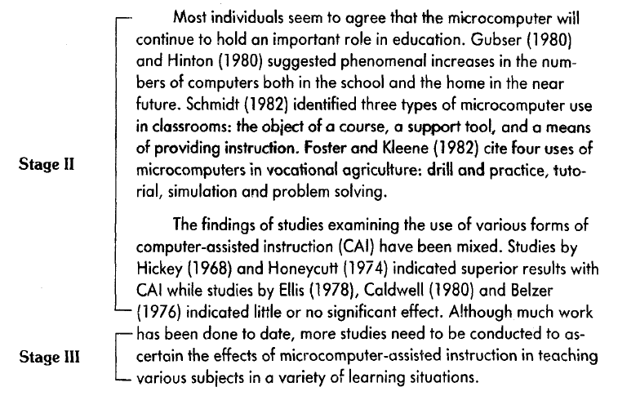

Slide 6
FIRST STAGE
General statements

Slide 7
FIRST Stage: The Setting
Begin with accepted statements of fact related to your general area.
Within the general area, identify one subarea.
Indicate your topic in the subarea.

Slide 8
FIRST Stage: Strong Opening Statement (1)
Strong Opening Statement:
In recent years… have been of great interest for…
The increasing interest in…has heightened the need for…
Of particular interest and complexity are…
The relationship between…has been investigated by many researchers.

Slide 9
FIRST Stage: Strong Opening Statement (2)
The…has become a favorite topic for analysis…
Knowledge of…has a great importance for…
The study of…has become an important aspect of…
A central issue in…is…
The…has been extensively studied in recent years.
Many investigators have recently turned to…

Slide 10
FIRST Stage: Strong Opening Statement (3)
Many recent studies have focused on…
Recently, there has been growing interest in…
The possibility of…has generated wide interested in…
The development of…has led to the hope that
(Notice how many of them use the present perfect. These are often general statements without citations. )

Slide 11
FIRST Stage: General and Specific Noun Phrases
Stage 1 of the introduction usually begins with factual statements about the general area which includes your specific topic.
When you write this kinds of general statements, it is conventional to use nouns that refer to objects or concepts at the highest possible level of generality. English offers several ways to construct these general nouns.

Slide 12
General vs Spesific Noun Phrases
General Noun Phrases
Statements in the setting of an introduction tend to be general in nature. Instead of referring to specific things, they refer to entire classes of things. Nouns referring to an entire class of things, you should use generic noun phrases.
Spesific Noun Phrased
Specific noun phrases are nouns that refer to particular individual members of a class rather than the class as a whole.

Slide 13
General Noun Phrases: Examples (1)
Generic Noun Phrases: Countable Nouns
No one can say exactly what it looks like when a planet takes ill.
Warm ocean water is like rocket fuel for typhoons and hurricanes.
Environmentalists and lawyers spent years shouting at one another about whether the grim forecasts were true.
As a tiny component of our atmosphere, carbon dioxide help warm Earth to comfort levels we are all used to

Slide 14
General Noun Phrases: Examples (2)
Generic Noun Phrases: Uncountable Nouns
The image of Earth as organism has probably been overworked.
Global warming is the real deal, and human activity has been causing it.
Warm ocean water is like rocket fuel for typhoons and hurricanes.
Water quality and its impact on human health have been perennial concerns

Slide 15
Spesific Noun Phrases
Specific noun phrases are nouns that refer to particular individual members of a class rather than the class as a whole.
Referring to assumed or shared Information. Use the definite article the if you assume your readers share knowledge of the specific thing you are referring to.
Referring to old information. Use the definite article the when referring to a specific thing which you have already mentioned (the first mention usually uses the indefinite article a/an).
Pointing forward to specifying information. Use the definite article the when the specific meaning is made clear in a following phrase or clause.

Slide 16
Referring to Shared Information
Example 1: By the end of the century, the world could be locked in to an eventual rise in sea levels of as much as 20 feet.
The shared information: the century, the world
Example 2: Given the complexities of the Earth’s biosphere, it is inevitable that some unfolding water trends will have both negative and positive consequences.
The shared information: the Earth’s biosphere

Slide 17
Referring to old information
Example 1: New Mexico Solar Energy Institute is developing a computerized diagnostic assistant for solar domestic hot water systems. The computer-implemented assistant will be used at naval shore facilities throughout the world.
Example 2: As a tiny component of our atmosphere, carbon dioxide help warm Earth to comfort levels we are all used to. The gas represents just a few hundred parts per million in the overall air blanket.
Example 3: What usually keeps the Gulf Stream running is that warm water is lighter than cold water, so it floats on the surface. As it reaches Europe and releases its heat, the current grows denser and sinks, flowing back to the south and crossing under the northbound Gulf Stream until it reaches the tropics and starts to warm again. The cycle works splendidly, provided the water remains salty enough.

Slide 18
Pointing forward to specifying information
Example 1: The forests that don’t succumb to fire die in other slow ways
Example 2: The gas which is produced in the western states is used primarily for home heating.
Example 3: The reason that we can live here is the Gulf Stream

Slide 19
Example Stage 1

Slide 20
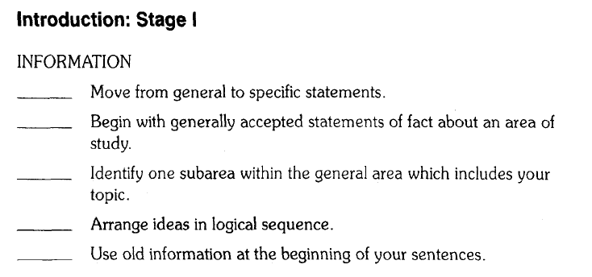
Summary

Slide 21
SECOND STAGE
More spesific statements

Slide 22
SECOND STAGE
More specific statements about the aspects of the problem already studied by other researchers
(Stage II supports the background information presented in Stage I.)
Citation Focus
When you cite the work of other authors, you may choose to focus either on the information provided by that author, or on the author him- or herself. The first focus we call information prominent because the information is given primary importance. The author’s name(s) and date of publication are parenthetically attached at the end of the sentence.

Slide 23
INFORMATION PROMINENT CITATION
Information + Reference
Examples:
In most deserts of the world, transitions between topographic elements are abrupt (Smith, 1968).
The literature on teaching effectiveness has established few theoretical grounds to guide the selection of meaningful variables. (Doyle, 1978)
The introduction of high strength, high flexibility materials has raised the need for a dynamic approach to floor design. (1,2,8,9).
Allen and Reiner (1) described graphically the differences between the various vibration scales.

Slide 24
Ordering of Citation
Citations grouped by approach:
One approach
+
Another approach
+
Still another
approach

Slide 25
Example Stage 1: Recap

Slide 26
Example Stage 2

Slide 27
THIRD STAGE
Missing Information

Slide 28
THIRD STAGE
Stage III serves to signal the reader that literature review is finished. It sums up the review by pointing out a gap—that is, an important area not investigated by other authors.
Usually Stage III is accomplished in only one or two sentences.

Slide 29
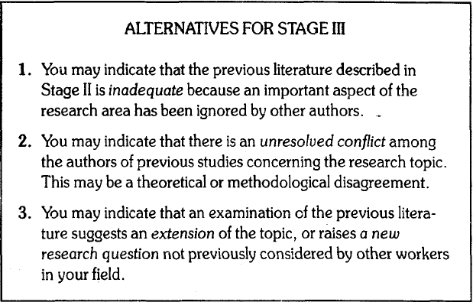
THIRD STAGE

Slide 30
STAGE 3: FORMULATION
Gap + Research Topic
However, few studies have the effects of computer
reported on assisted instruction.
But there is little information the air flow rates on
available on simple flat plate solar
collectors.

Slide 31
Example Stage 3

Slide 32
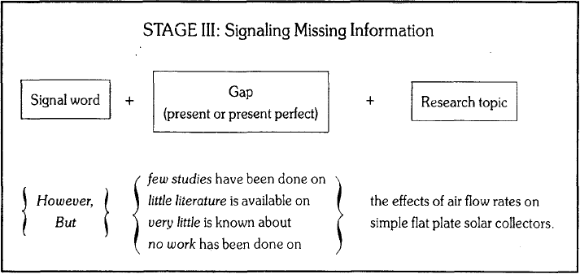
STAGE 3: SIGNAL WORDS (1)
Special signal words are commonly used to indicate the beginning of Stage 3.

Slide 33
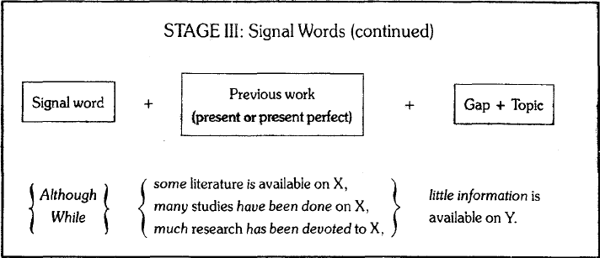
STAGE 3: SIGNAL WORDS (2)
Special signal words are commonly used to indicate the beginning of Stage 3.

Slide 34
FOURTH STAGE
The Statement of Purpose

Slide 35
FOURTH STAGE: Thesis Statement
Stage IV serves to state as concisely as possible the specific objectives of your research report.
This stage, the statement of purpose, thus follows directly from Stage III because it answers the need expressed in Stage III for additional research in your area of study.

Slide 36
FOURTH STAGE: Two Alternative Orientations
The orientation of the statement of purpose may be towards the report itself—that is, it may refer to the paper (thesis, dissertation, or report) that communicates the information about the research.
Or the orientation of the statement of purpose may be towards the research activity or the study itself, rather than the written report.

Slide 37
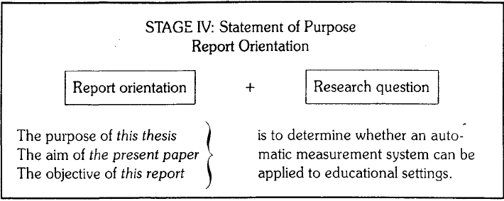
STATEMENT OF PURPOSE: Report Orientation

Slide 38
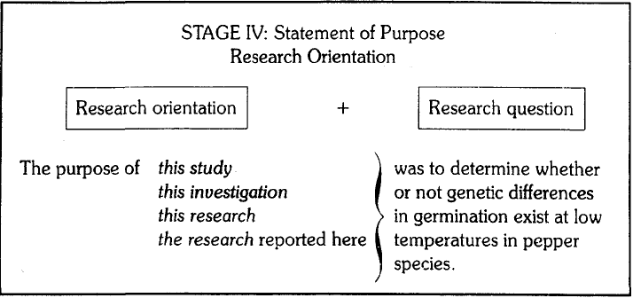
STATEMENT OF PURPOSE: Research Orientation

Slide 39
Example Stage 4

Slide 40
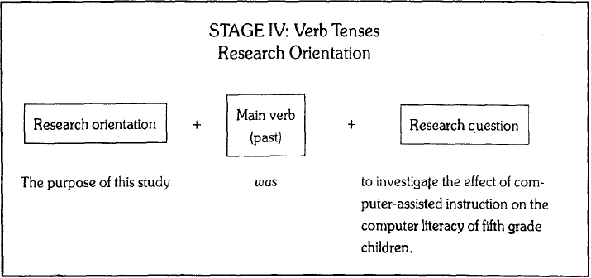
STAGE 4: ORIENTATION AND TENSES (1)
If you choose the research orientation you should past tense, because the research activity has already been completed.

Slide 41
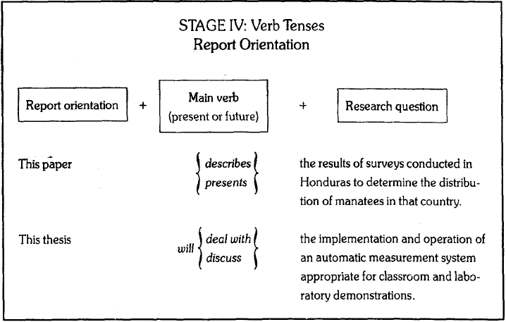
STAGE 4: ORIENTATION AND TENSES (2)
On the other hand, if you choose to use the report orientation, use the present or future tense.

Slide 42
NOTES IN STAGE 4: Research Question
Stage 4 and Your Research Question: This is your thesis statement.
Your statement of purpose should be directly related to the research question upon which you based your study. Although you may not need to include the research question explicitly in your report, the statement of purpose should be written so that your reader can infer the research question behind your study.
If the implied research question is a yes and no question, the connecting words whether or if are used in Stage IV, and a modal auxiliary like would or could accompanies the verb.

Slide 43
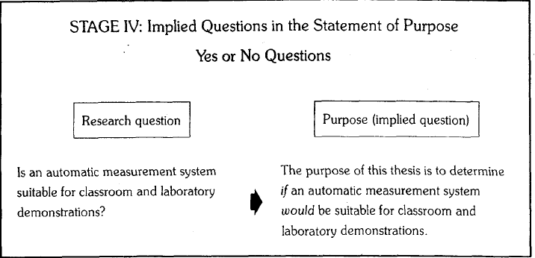
Implied Questions in Statement of Purpose (Yes or No Question)

Slide 44
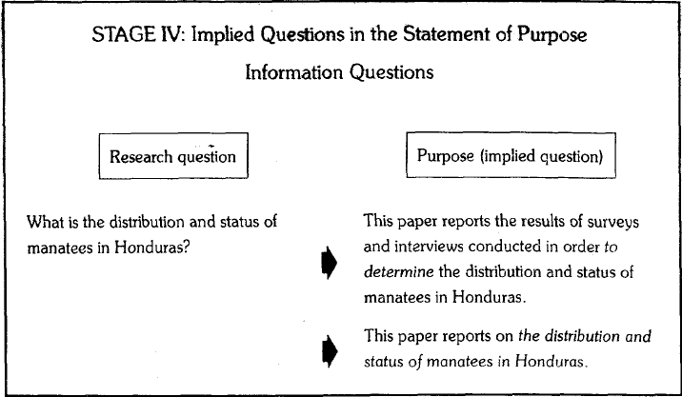
Implied Questions in Statement of Purpose (Information Questions)

Slide 45
FIFTH STAGE
The Statement of Value

Slide 46
FIFTH STAGE: The Statement of Value
In Stage V you justify your research on the basis of some possible value or benefit the work may have to other researchers in the field or to people in practical situations. We can call this stage the statement of value.
You may write Stage V from two alternative points of view (orientation):
practical benefits orientation and/or
theoretical importance orientation.

Slide 47
The Statement of Value: Practical Benefits
The statement of value may be written from the point of view of practical benefits which may result from applying the findings of your research.
Example A: This research may provide an alternative to the problem of manually demonstrating instrumentation principles in classroom environments.
Example B: The results of this study could be useful to educators responsible for planning course work in consumer education.

Slide 48
The Statement of Value: Theoretical Importance
You may write the statement of value to emphasize the theoretical importance of your study in advancing the state of knowledge in your specific area of study.
Example A: Both of the factors under investigation in this study may be of importance in explaining the irregular occurrence of this disease.
Example B: Results of this study may suggest a broader hypothesis for further research into the effects of atmospheric chemicals on rubber.

Slide 49
Example Stage 5

Slide 50
STAGE 5: Model Auxiliaries and Tentativeness
Stage 5, the statement of value is usually written in a way that suggests an attitude of tentativeness or modesty on the part of the author.
When reporting your own study, you should not sound too sure of the benefits, either practical or theoretical, of your work.
It is conventional to sound more cautious.
This is accomplished in Stage 5 by using modal auxilarities, principally “may”.

Slide 51
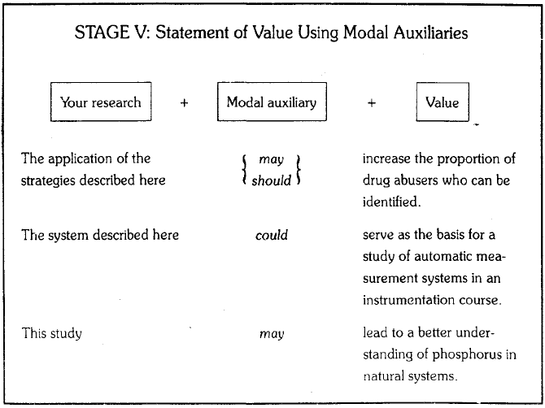
STAGE 5: Using Model Auxiliaries

Slide 52
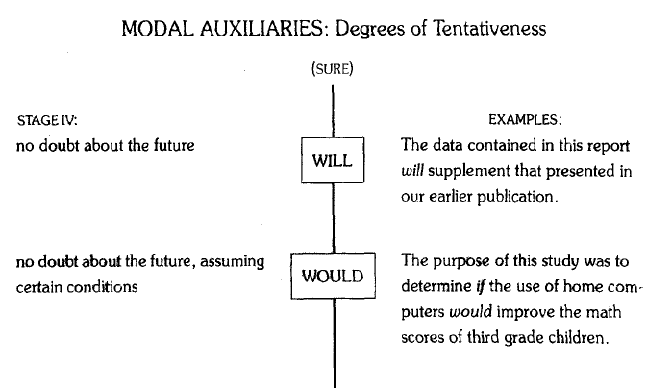
Selecting the Best Modal Auxiliaries for Use in Stages 4

Slide 53
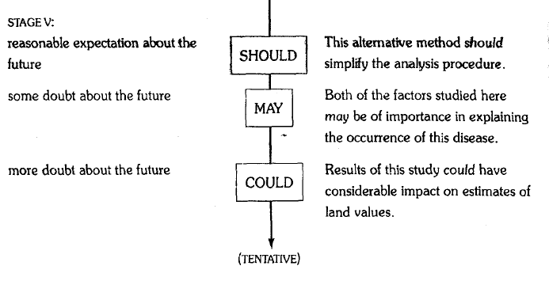
Selecting the Best Modal Auxiliaries for Use in Stages 5

Slide 54

Thank you for your time!
ANY QUESTIONS?
Services Computing Research Group
School of Electrical Engineering and Informatics
Institut Teknologi Bandung

