Slide 1
“Internet of Farming” Potensi Riset dan Pengembangannya
Kuliah Umum, FTI, UNAND
Padang, 9 Agustus 2017
Rahmat Budiarto
Professor,
CIS Dept, College of CSIT
Albaha University, KSA
rahmat@baha.edu.sa

Slide 2
Outline
About Rahmat
Jaringan Internet of Things (IoT), Pengantar
Konsep IoT
Contoh-contoh:
Di tubuh manusia, di rumah, di perkotaan, di industry, di lingkungan alam
Konsep Internet of Farming (IoF)
Konsep dasar: sensor, jaringan, perangkat lunak
Existing systems
Baha-FIST
Potensi Riset & Pengembangan
Teknologi sensor
Teknologi jaringan
Sistem aplikasi/perangkat lunak

Slide 3
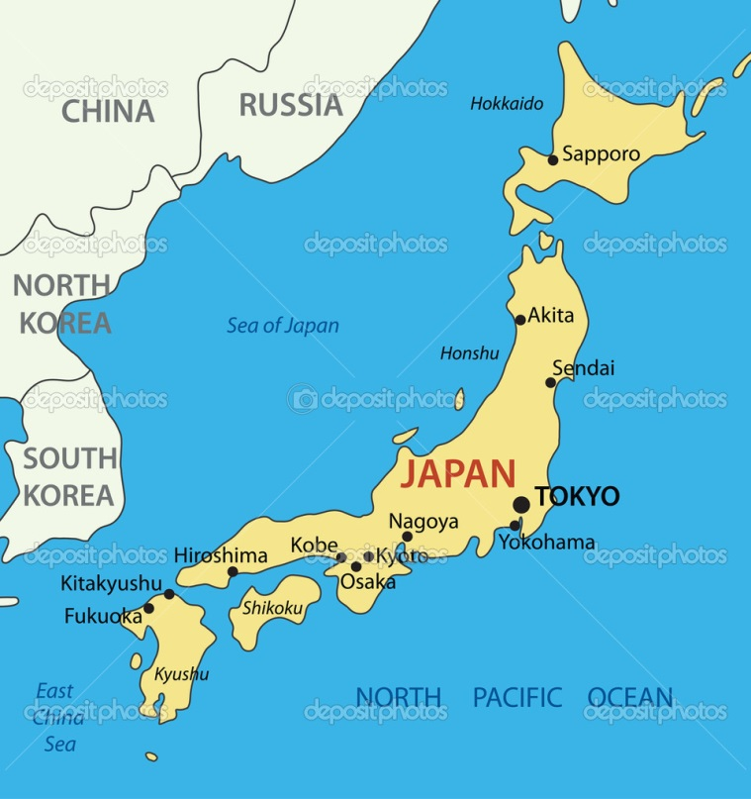
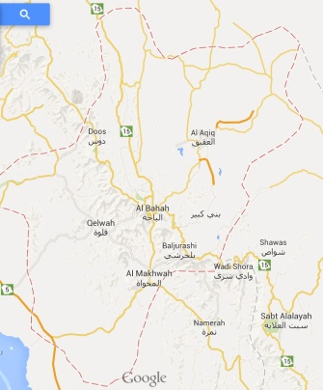
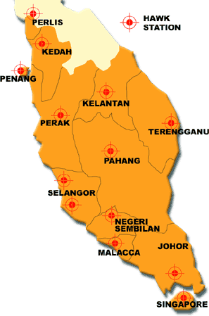
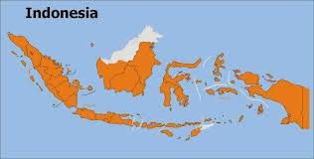
I am Javanese
and
I speak Japanese
About rahmat
Jakarta
Java

Slide 4
Background
PhD in Comp. Engineering from Nagoya Inst. Of Tech. Japan (1998)
10 years industrial experiences
> 15 years as academic
Was:
Deputy Director/Co-founder NAV6-Center, USM, M’sia (2005-2009)
Chair, Security Working Group, APAN (2006-2008)
Chair, Fellowship Committee, APAN (2007-2008)
Member, Steering Committee, ID-IPv6TF (2013-2015)
Member, Steering Committee, Cyber-Army Project KODAM 7 Wirabuana (2013)
Research Publications: >250 (>105 SCOPUS indexed)
Research Grants > 15
Awards….

Slide 5
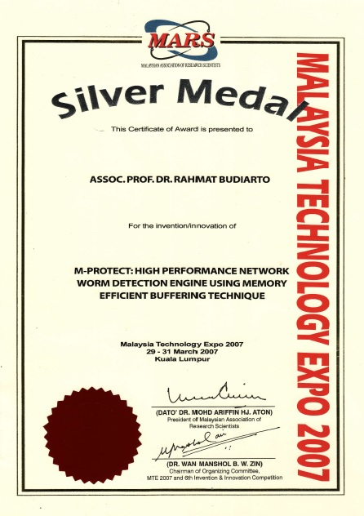
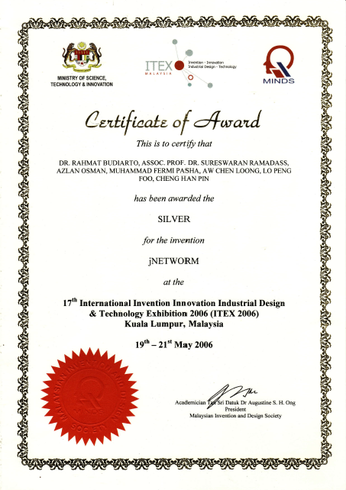

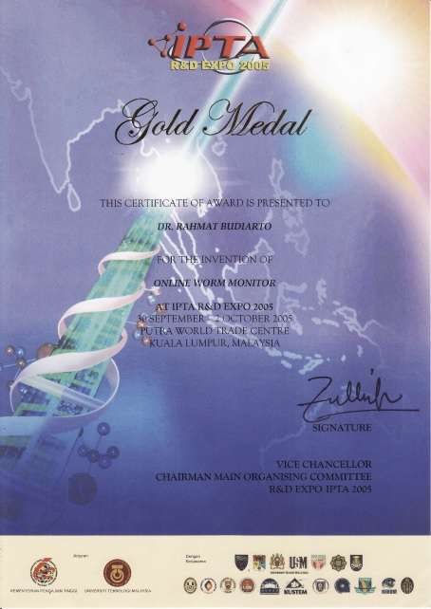
R&D&C

Slide 6
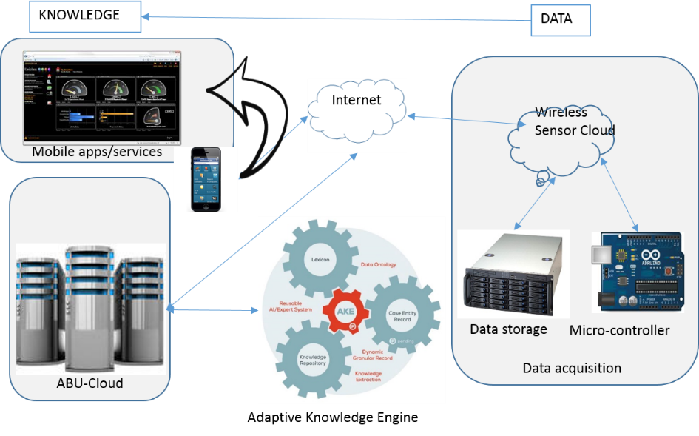
Current researches
Optimizing the ERP development in Albaha university (Research grant under Albaha Univ.)
Smart Baha Internet of Farming Systems (Research grant under Albaha University)
Baha-Sensor Cloud
Mobile Farming System
Baha Cloud
Adaptive Knowledge Engine for Big Data in farming

Slide 7
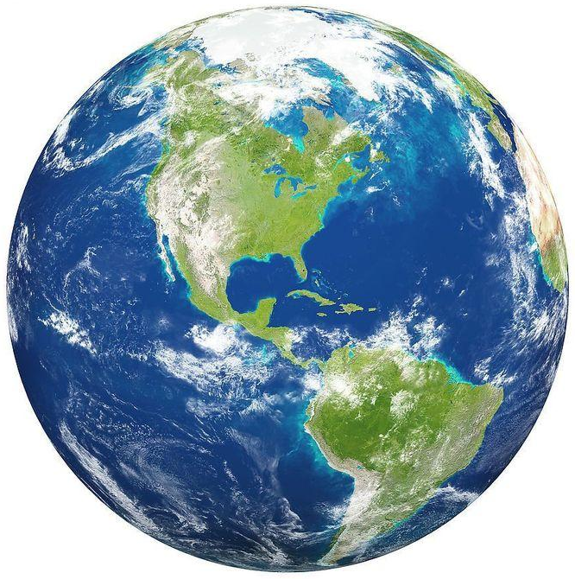
The Internet of Things (IoT)
The Internet
Smart Earth:
An IBM Dream
Internet
Clouds
Internet of Things
Smart Earth
M2M (Machine to Machine)
“Internet of Everything” (Cisco Systems)
“World Size Web” (Bruce Schneier)
“Skynet” (Terminator movie)

Slide 8
Opportunities of IoT in 3 Dimensions
(courtesy of Wikipedia, 2010)

Slide 9
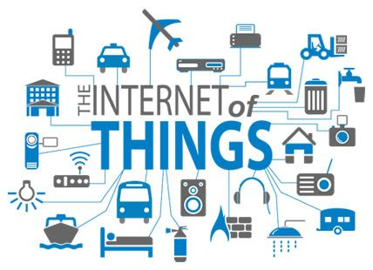
Internet of Things
The interconnection via the Internet of computing devices embedded in everyday objects, enabling them to send and receive data.
combine sensors, actuators, and networked intelligence.

Slide 10
Applications
Human body: Sensors + connectivity
Home: Remotely monitor and manage your home and cut down on your monthly bills and resource usage.
City: Engage with the data exhaust produced from your city and neighborhood
Industry: Optimize operations, boost productivity and save in resources and costs
Environment: Understand and better manage what we currently have

Slide 11



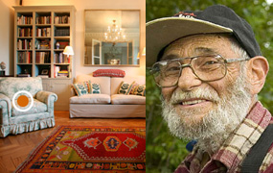


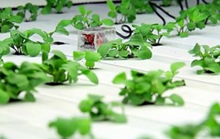

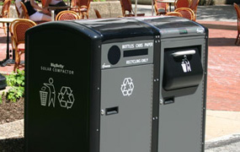
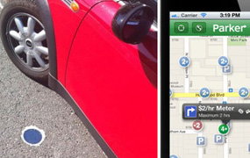
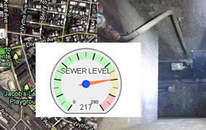
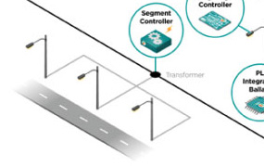
https://www.postscapes.com/internet-of-things-examples/

Slide 12
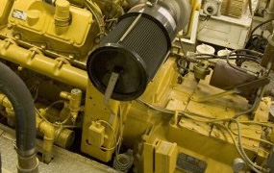
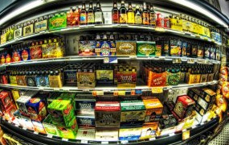
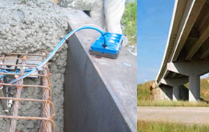
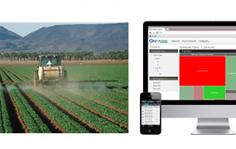
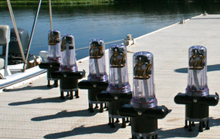
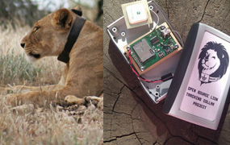
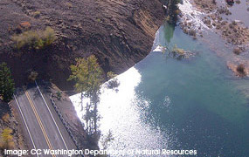
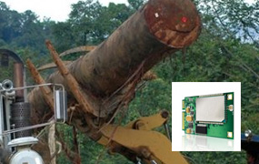

Slide 13
Wireless Body Area Network

Slide 14
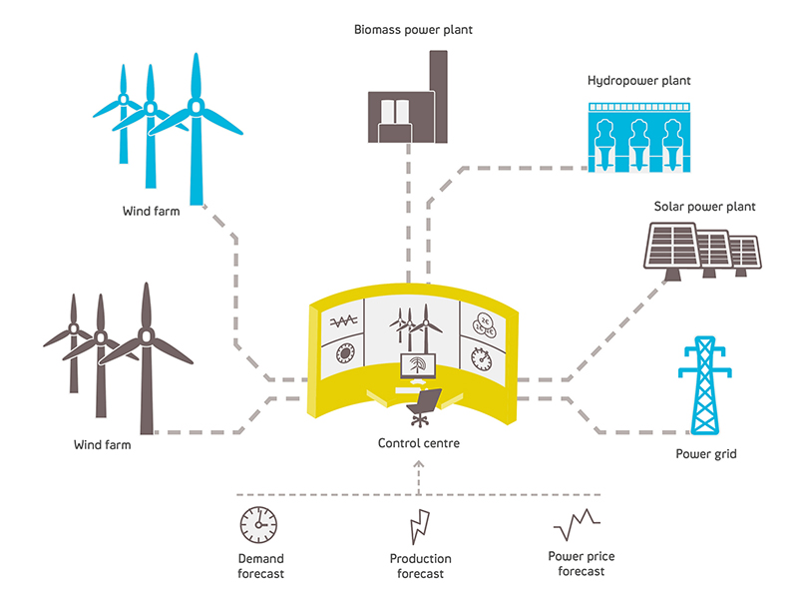
E-energy/E-grids

Slide 15
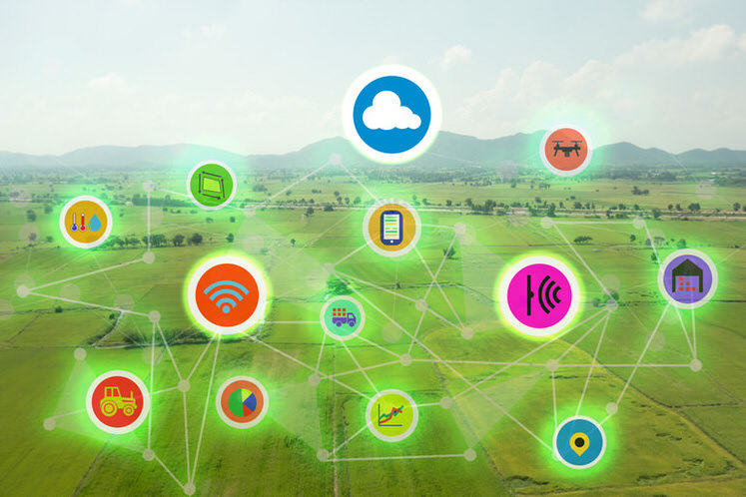
Internet of Farming

Slide 16
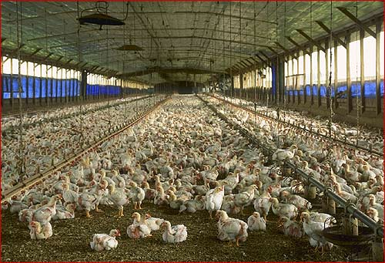

Slide 17
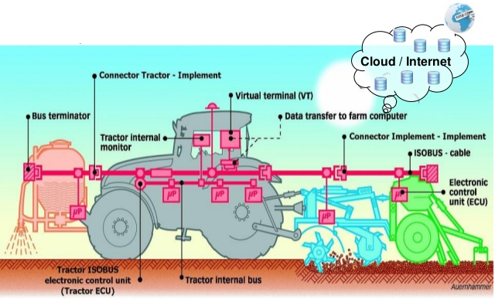
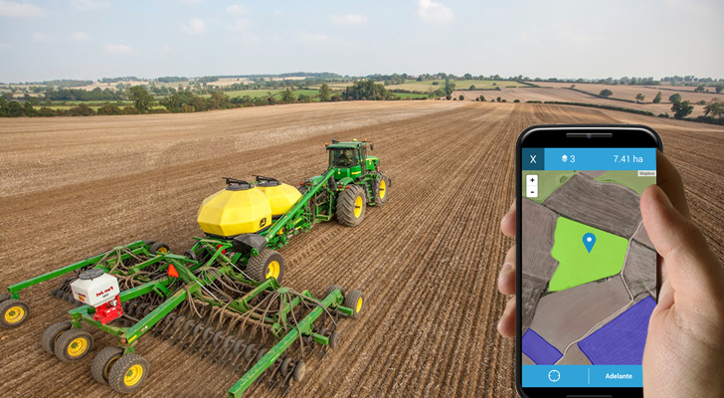
Sensors equipped tractors
Tractor and the attached sensors are as one network…

Slide 18
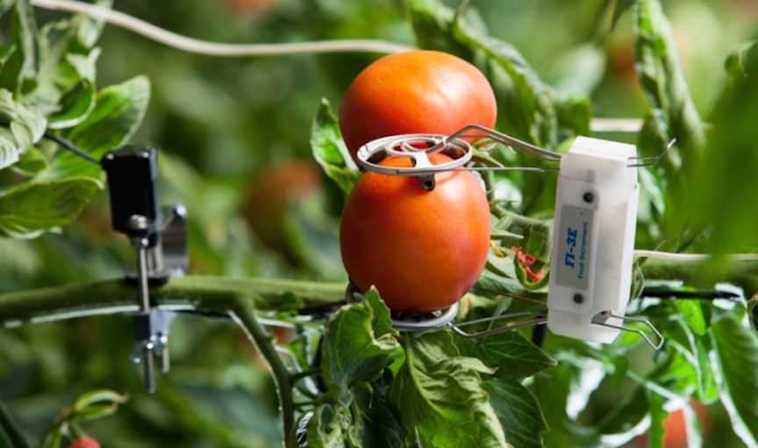
Sensors…

Slide 19
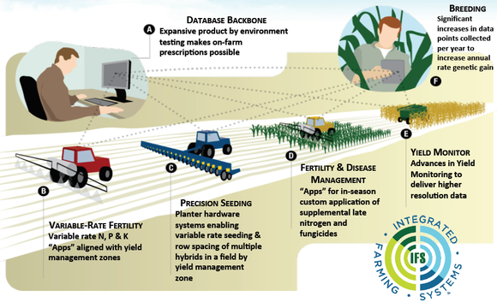
Integrated Farming Systems

Slide 20
Baha Smart Internet of Farming System

Slide 21
Background/motivation
Albaha farmers still practicing traditional farming techniques
Albaha university vision & mission on contribution to the local community

Slide 22
Problem statement
In order to improve and to sustain quality of farming products, farmers in Albaha need farming information systems that utilize the information and communication technologies.
Existing modern farming information systems which is based on Internet of Farming are complex, expensive, less accuracy and not localized to meet local needs and environment.

